Slide 1


Case Based Discussions - Diabetic Foot
Mr David Russell
Consultant Vascular Surgeon, Leeds Vascular Institute
Vascular Lead, Leeds Diabetes Limb Salvage Service

Slide 2
Incidence of Amputation in England
Lost Limb | 2010-11 | 2011-12 | 2012-13
Leg | 5,061 | 4,701 | 4,669
Foot | 785 | 980 | 1,040
Toe | 5,512 | 6,021 | 5,951
Total | 11,358 | 11,701 | 11,660
APPG on Vascular Disease, March 2014

Slide 3
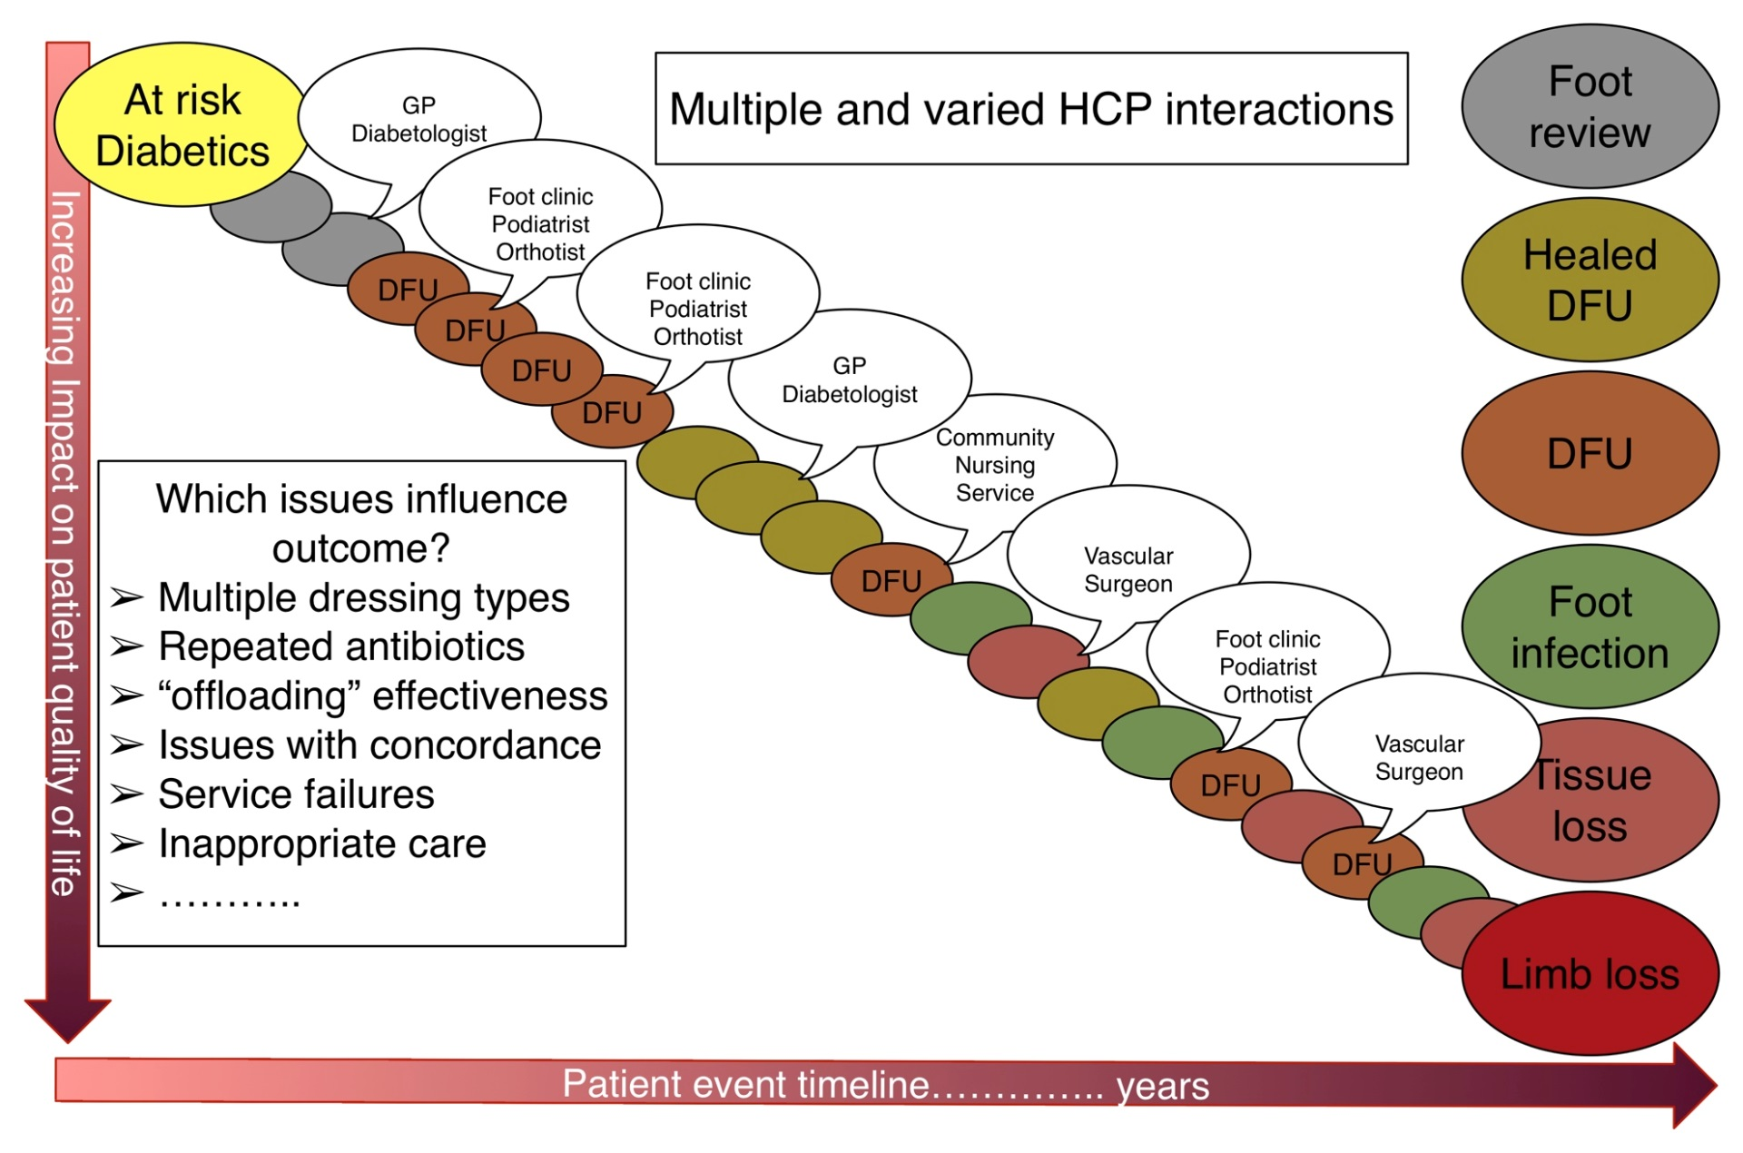
One patient’s foot pathway

Slide 4
The Diabetic Foot

Slide 5
The Diabetic Foot
Neuropathy
Infection
Ischaemia

Slide 6
Learning Objectives
Understand the aetiology of diabetic foot problems
Be aware of the strategies to prevent and manage diabetic foot complications
  Risk stratification
  Offloading
  Management of infection
  Assessment and management of ischaemia

Slide 7
Case History
56 year old gentleman
New diagnosis Type 2 diabetes
What foot care should be put in place?

Slide 8
Assessment of the Intact Diabetic Foot (NG19)
Assessment in the Community
(Trained Individual)
Low Risk:
No risk factors except callus alone
Annual inspection:
Inspect for deformity
Test sensation
10g monofilament
vibration
Palpate foot pulses
Inspect footwear
Patient Education
Increased Risk:
Deformity or Neuropathy or Non-critical ischaemia
3-6 monthly review by foot protection team:
Patient Education
Evaluate biomechanics and footwear
Re-assess vascular status
Liaise to optimise diabetes and risk factors
High Risk:
Previous ulcer/amputation or RRT or Neuropathy+limb ischaemia or Neuropathy+callus/deformity or Ischaemia+callus/deformity
1-2 monthly review:
Intensified patient education
Specialist footwear
Re-assess vascular status
Skin and nail care
Risk factor management

Slide 9
Case History
Same 56yr gentleman
Has foot check, no palpable pulses but good signal on HHD so defined as low risk. No foot care education.
Develops plantar 5th MT head ulcer
  Managed by GP for 3 months
  2 short courses antibiotics (flucloxacillin 250mg qds for 7 days)
  Progressing so sent in to Limb Salvage MDT clinic

Slide 10
Case History
What is the initial assessment and management in clinic?

Slide 11
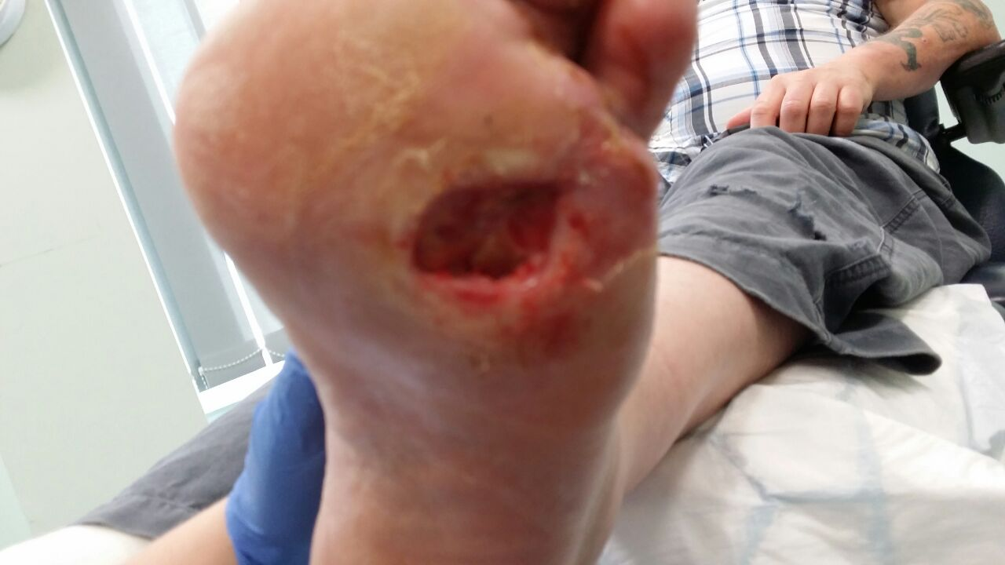
Case History
What is the initial assessment and management in clinic?
History and risk factors
Lifestyle and social factors
Neuropathy
Vascular assessment
Wound assessment

Slide 12
Vascular Assessment
Neuropathy is associated with medial calcinosis and abnormal autonomic responses which affects all recognised bedside tests
  ABPI inaccurate in 40%
  TBI inaccurate / not measurable in 30%

Slide 13
Assessment of Ischaemia
Vriens B et al. Diabet. Med. 2018; 35: 895–902

Slide 14
Assessment of Ischaemia
Vriens B et al. Diabet. Med. 2018; 35: 895–902

Slide 15
Assessment of Ischaemia
Vriens B et al. Diabet. Med. 2018; 35: 895–902

Slide 16
Wound Assessment
TIME
Tissue
  Debridement of non-viable material
    Surgical/hydrosurgical
    Enzymatic
    Hydrolytic
Infection/Inflammation
Moisture imbalance
Edge of wound

Slide 17
Wound Assessment
Probe to Bone Test (PTB)
  PPV= 0.57; NPV= 0.98 [~20% prev.] (Lavery 2007)
  PPV= 0.95; NPV= 0.91 [~80% prev.] (Lozano 2010)
Classification systems
  Texas
  WIFi
  SINBAD

Slide 19
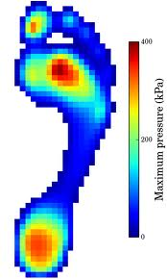
Off-loading the diabetic foot
Peak pressures up to 1000kPa
Repetitive pressure insult, with shear forces, leads to ulceration
Misnomer – all strategies aim to redistribute pressure

Slide 20
Off-loading footwear – pressure reduction
Modified from Cavanagh PR et al. JVS 2010; 52(12S): 37S-43S

Slide 21
Off-loading footwear – healing
Modified from Cavanagh PR et al. JVS 2010; 52(12S): 37S-43S

Slide 22
Off-loading footwear - problems
Both NICE and IWGDF recommend TCC
  Contra-indicated in infection and significant ischaemia
  Long application time
  Only offered as routine footwear in 2% US centres²
Compliance is poor with removable devices¹
iTCC quicker to apply, equally effective³
Armstrong DG et al. Diabetes Care 2003; 26: 2595-7
Wu SC et al. Diabetes Care 2008; 31(11): 2118-9
Armstrong DG et al. Diabetes Care 2005; 28(3): 551-4

Slide 23
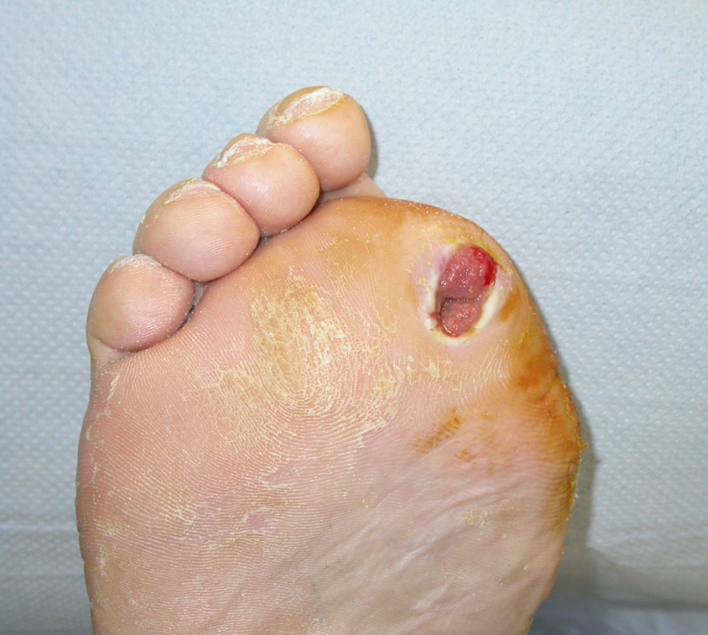
Off-loading – surgical options
Consider implications of debridement and minor amputation decisions
Study of 90 hallux or 1st ray amputees
  60% 1 further amputation
  21% 2 further amputations
  7% 3 further amputations
Murdoch DP et al. Journal Foot and Ankle Surgery 1997; 36(3): 204-8

Slide 24
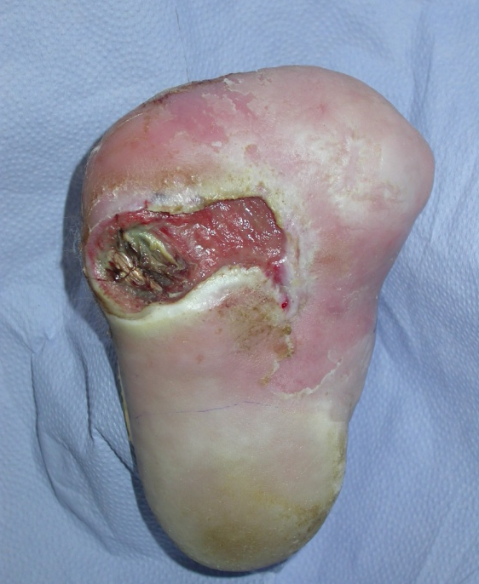
Off-loading – surgical options
Percutaneous Achilles tendon lengthening
  Reduces forefoot pressures and helps healing and minimises recurrent of plantar forefoot ulceration¹
  Reduces recurrent ulceration following transmetatarsal amputation
1. Frykberg RG et al. Surgical off-loading of the diabetic foot JVS 2010; 52(12S): 44S-58S

Slide 25
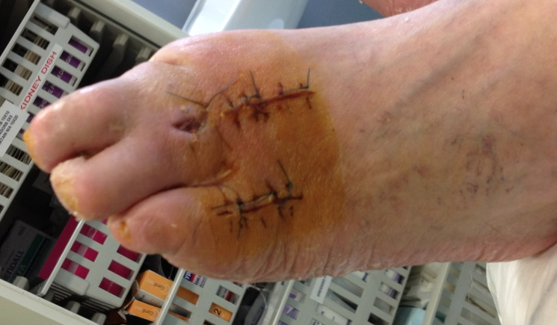
Off-loading – surgical options
Digital ulcers
  Tenotomy
  Arthroplasty
Charcot foot
  Exostectomy
  Midfoot, hindfoot and ankle arthrodesis
Plantar forefoot ulcers
  Metatarsal osteotomy
  Metatarsal head excision

Slide 26
Case History
Despite off-loading and best wound care, has now developed cellulitis around ulcer, dorsal 5th MT head and tracking to midfoot.
  Systemically well
  CBG 15mmol/mol
  Ulcer probes to bone
What is your management plan?

Slide 27
Diagnosis- Soft tissue infection
IDSA (Lipsky et. al. 2012)

Slide 28
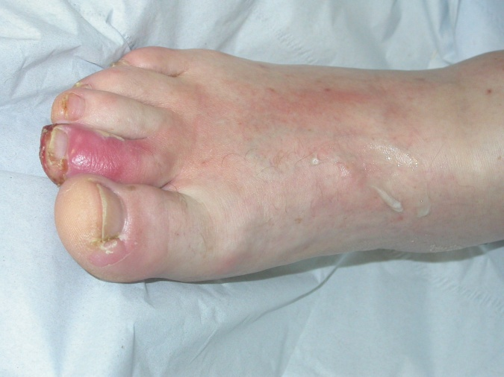
Diagnosis- Osteomyelitis
Clinical
  “Sausage toe”
  Depth and size of ulcer
    Not sensitive or specific when used alone (Dinh 2008; Butalia 2008)
  Probe to Bone Test (PTB)

Slide 29
Diagnosis- Osteomyelitis
Bone Biopsy Histology:
    Used as reference standard
    Meyr et. al. 2011- Complete agreement in 1/3 of specimens only
    Weiner et. al. 2011- as likely to find a false negative with histology as with microbiology
Bone Biopsy Culture:
    Sensitivity 75% (NPV 39%) (Weiner 2011)
    Contamination of taken through base of wound
    High False Neg rate (ABx exposure, small sample volume etc.)
Combined Histo/Micro Bone Bx
    Sensitivity improves to 84% (Weiner 2011; White 1995)

Slide 30
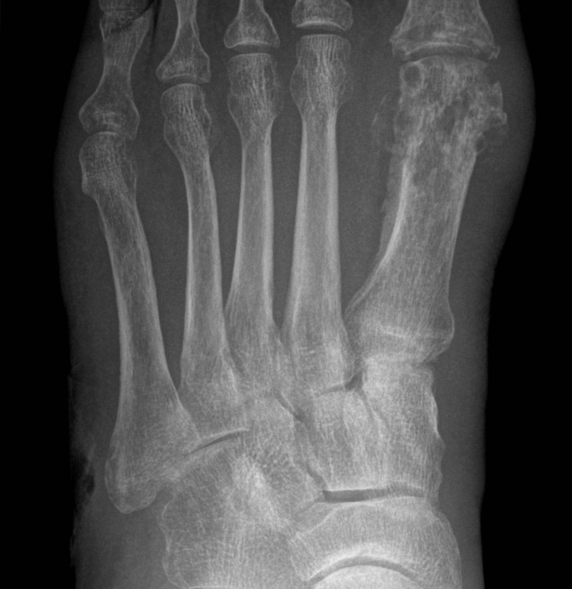
Diagnosis- Osteomyelitis
Radiology
  Plain XR:
    Sensitivity 0.54 (CI 0.44–0.63)
    (timing of test/pop. prevalence)
    Specificity 0.91 (CI 0.86–0.94)
  MRI:
    Sensitivity 0.90 (CI 0.82–0.95)
    Specificity 0.79 (CI 0.62–0.91)
    (Dinh 2008)

Slide 31
Diagnosis- Osteomyelitis
Less useful Investigations:
  Bone Scan (Sens. 81% / Spec. 28%)
  Labelled WBC scan (Sens. 74% / Spec. 68%)
  Needle aspiration: 23-46% correlation to bone culture
  Sinus Tract swabs: 44% correlation to bone culture but possibly better with consecutive cultures

Slide 32
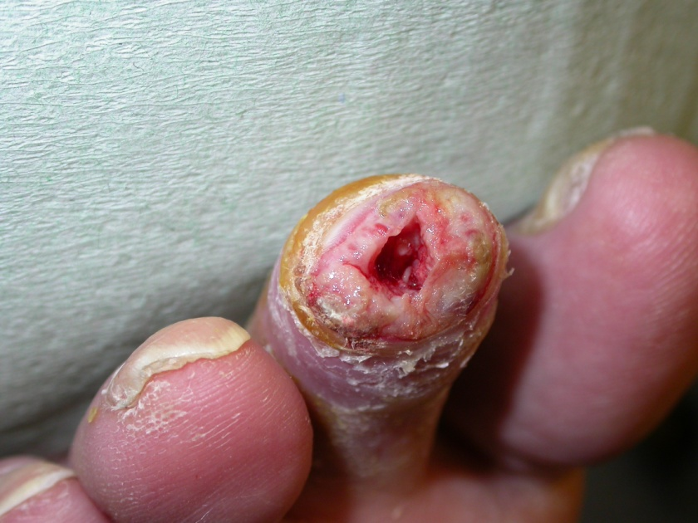
Sampling- Osteomyelitis
Why?
  Improved outcomes (Senneville et. al. 2008)
  Reduced resistance
Open or Percutaneous Bone Biopsy
  Pros
    Clean contamination free specimen
  Cons
    Difficult to obtain in timely fashion
    Technically difficult from distal bones
    Creates further breech in skin integrity
    Small volume specimens

Slide 33
Antibiotics vs Surgical Management
Significant biomechanical sequelae to minor amputation / bone excision
Meta-analysis of 435 hallux amputations¹
  19.8% re-amputation at 26 month follow-up
    Additional digit 37.2%
    TMA 32.6%
    BKA 29.1%
82% 12 month remission rate in patients treated primarily with 6 weeks of targeted antibiotic therapy²
2 RCTs showed no difference in primary healing surg vs ABs³
Borkosky SL et al Diabetic Foot and Ankle 2012; 3: 12169
2. Game FL et al Diabetologia 2008; 51(6): 962-967
3. Lazaro-Martınez JL et al. Diabetes Care 2014;37:789–795

Slide 34
Antibiotic Treatment- Principles
DFI is different to other soft tissue infections
Antibiotic Resistance
    Be sure of the diagnosis (to avoid over-prescribing)
    Good Sampling: Empiric → Targeted regimen
Site/Depth of infection
IV vs. Oral
Duration

Slide 35
Antibiotic Treatment- Duration

Slide 36
Revascularisation
No good test to determine need for revascularisation:
  ABPI <0.5
  Ankle systolic pressure <50 or <70mmHg
  Toe pressure <30mmHg
  TcPO₂ <30mmHg
Be more aggressive with infection and large soft tissue defects
Good quality imaging including the foot
Consider enrolling to Basil-2

Slide 37
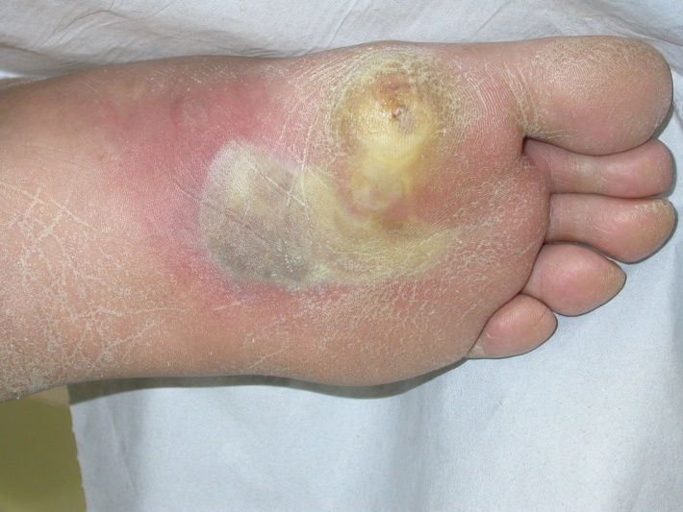
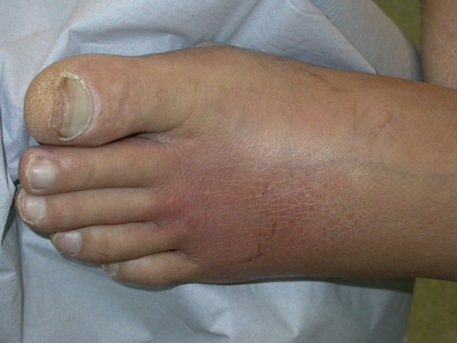
Case History
63 year old Type 2 diabetic
Flu like symptoms for 3 days
CBG 29mmol/mol
Noticed some swelling and pain in left foot over last 48 hours
Management plan?

Slide 38
Drainage of Sepsis - When I do it
Considerations:
  Infection vs ischaemia
  Debridement vs definitive management
  Residual biomechanics
Pus needs urgent drainage and debridement
  Fluctuance
  Deep plantar tenderness (especially with dorsal erythema)
  Pus following debridement of unhealthy tissue
  Remote sinuses
  Soft tissue gas on plain Xray
“Time is tissue”

Slide 39
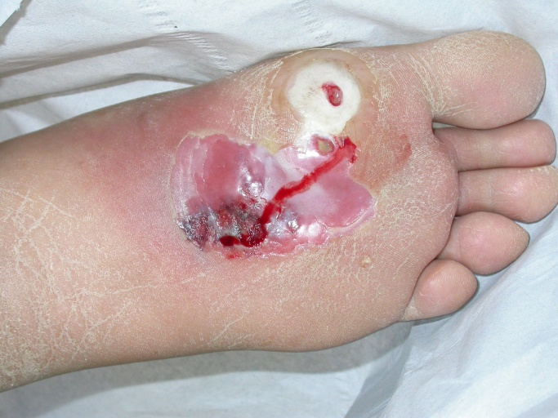
Drainage of Sepsis - How I do it
MDT approach
Fluid resuscitation as required
Pus/deep tissue sample antibiotic naive
Early antibiotic therapy (broad spectrum as per local policy)

Slide 40
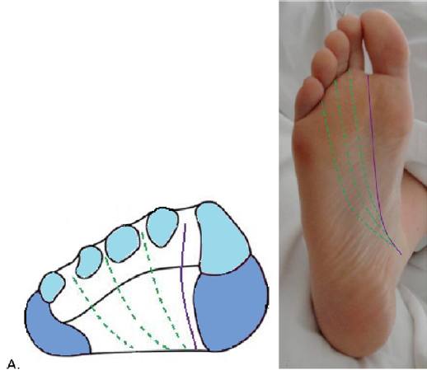
Drainage of Sepsis - How I do it
Loeffler-Ballard incision
Debridement to healthy tissue
  White
  Yellow
  Pink
  Healthy vessels
  Bleeding skin edges
Clean tissue for microbiology and histology
Preserve healthy tissue for reconstruction

Slide 41
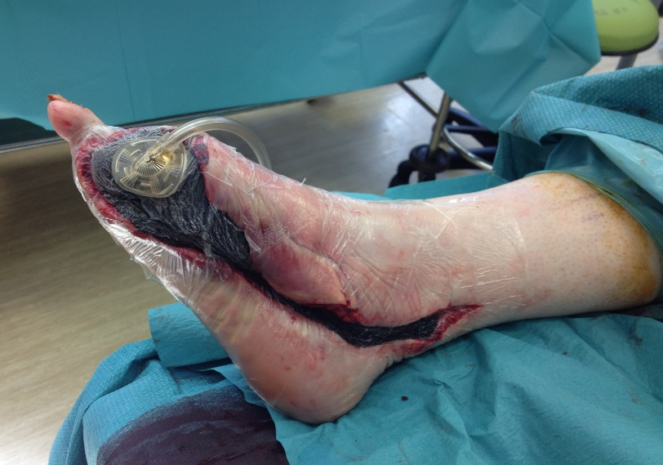
Drainage of Sepsis - How I do it
Negative pressure therapy post-op
May need serial debridements
Urgent vascular imaging and revascularisation (open)
Antibiotics
  Based on clean tissue and bone specimens
  2 weeks for soft tissue
  6 weeks for bone

Slide 42

Examples

Slide 43
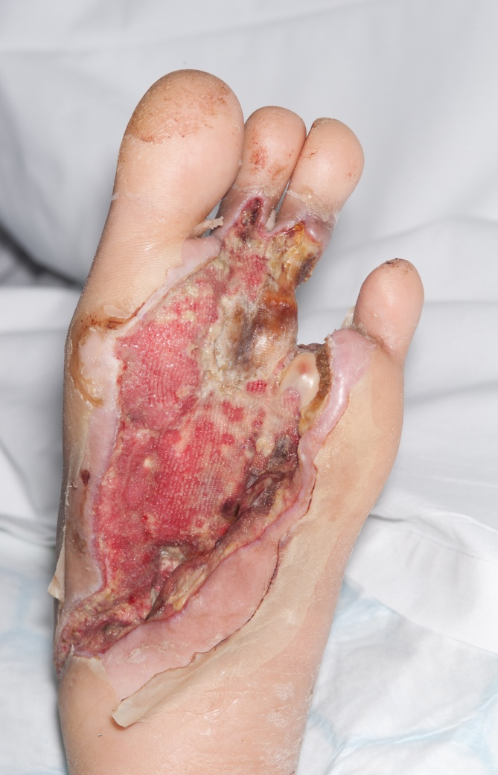
Examples

Slide 44
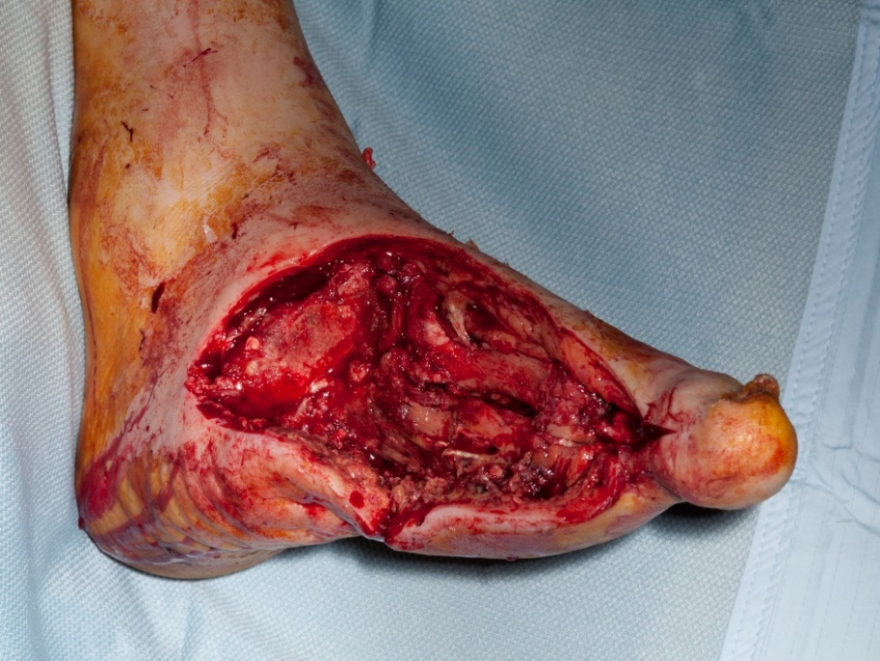
Use of Available Tissue
Reconstructive options:
  Need to consider at time of first debridement
  MDT discussion
  Use available soft tissue for local flaps
  Split skin graft
  Free flaps
  Dermal substitutes
May need tendon transfer for ongoing stability

Slide 45
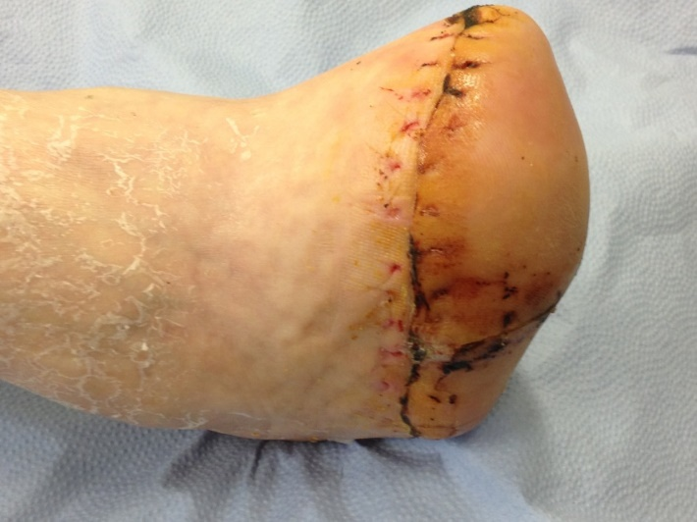

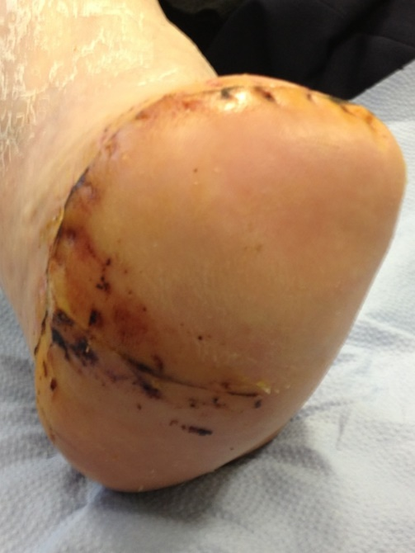
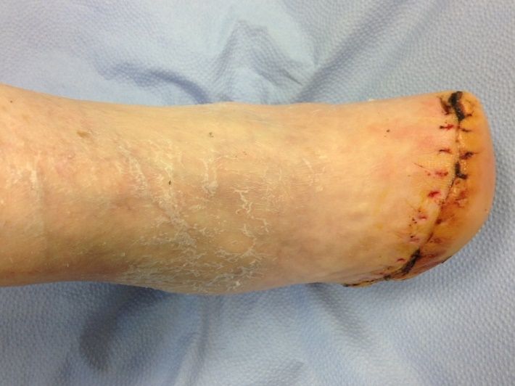
Use of Available Tissue

Slide 46
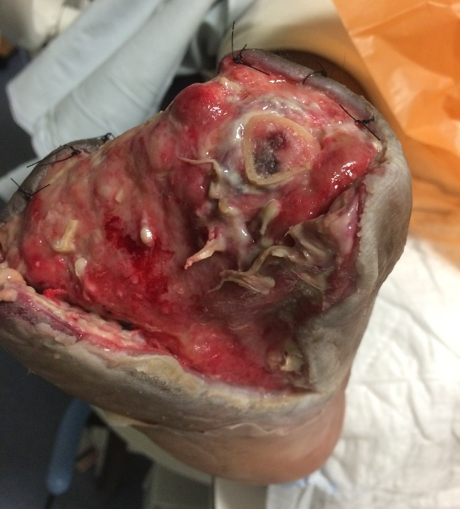
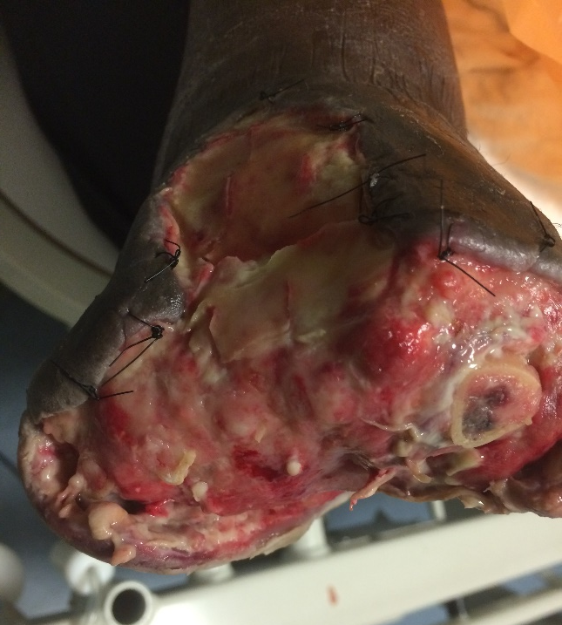

Slide 47
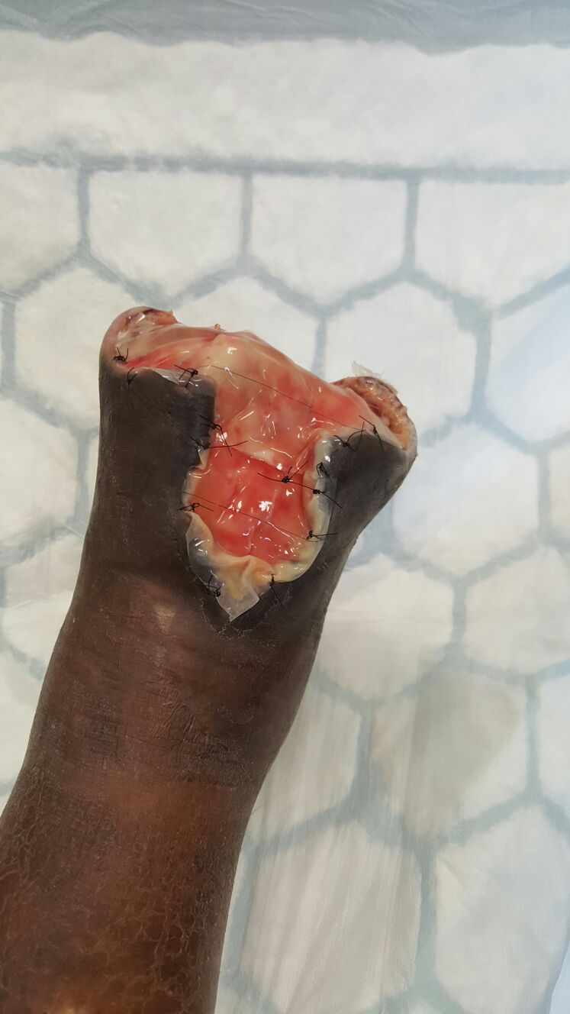
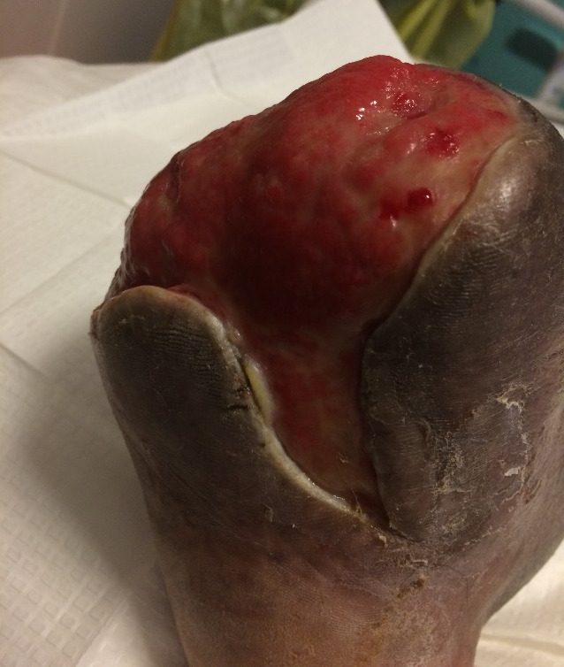
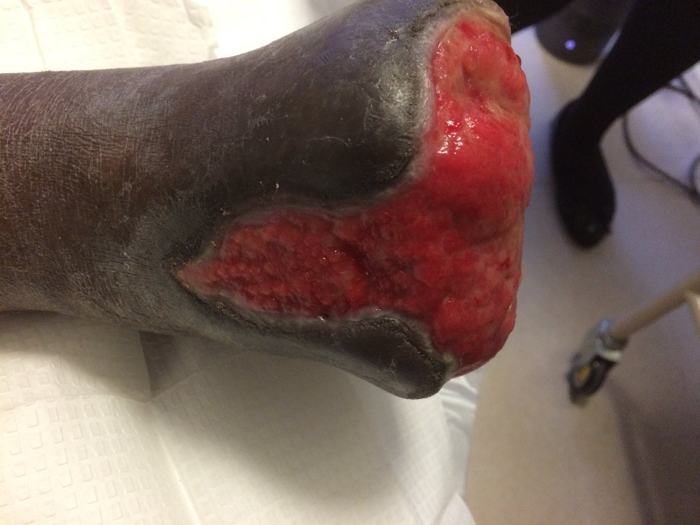

Slide 48
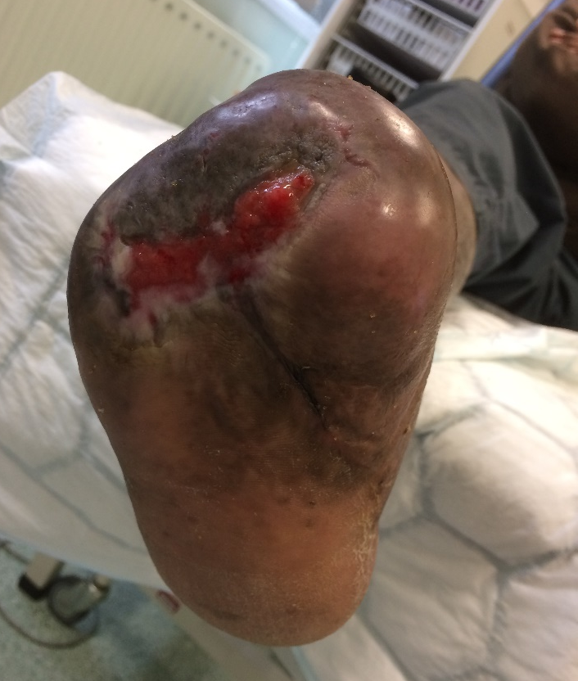
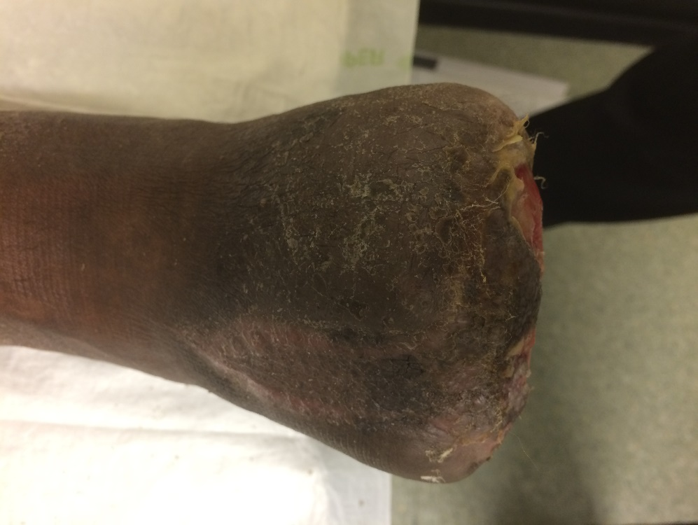

Slide 49
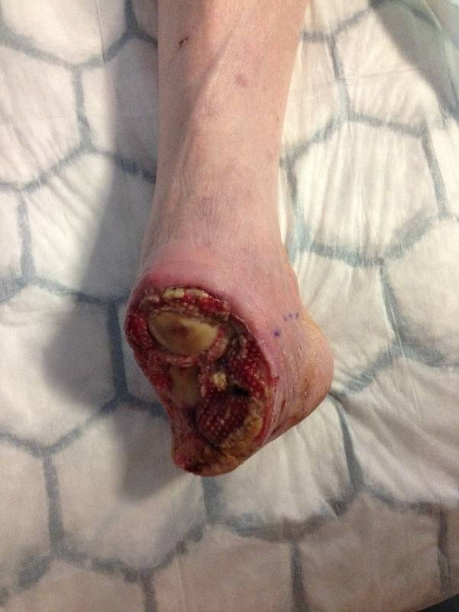
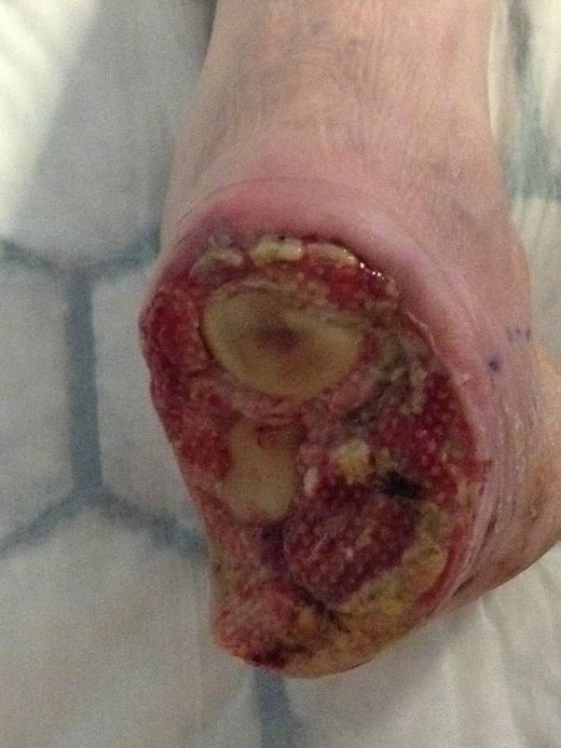
Dermal Substitutes

Slide 50
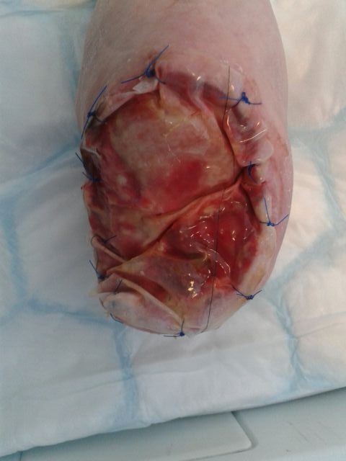
Dermal Substitutes

Slide 51
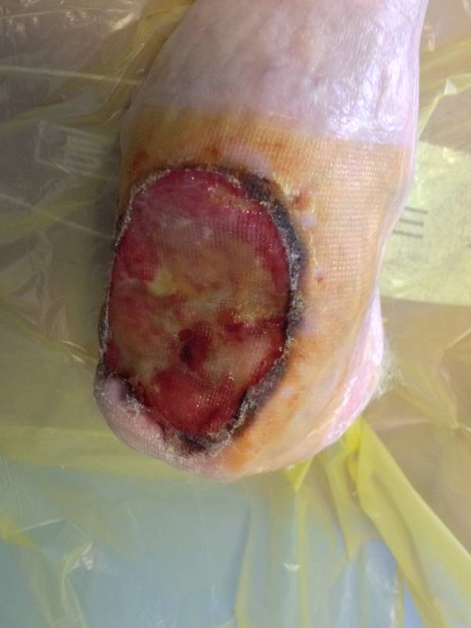
Dermal Substitutes

Slide 52
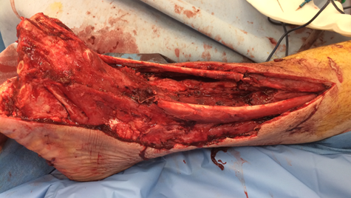
Free Flaps

Slide 53
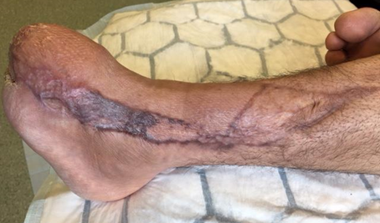
Free Flaps

Slide 54
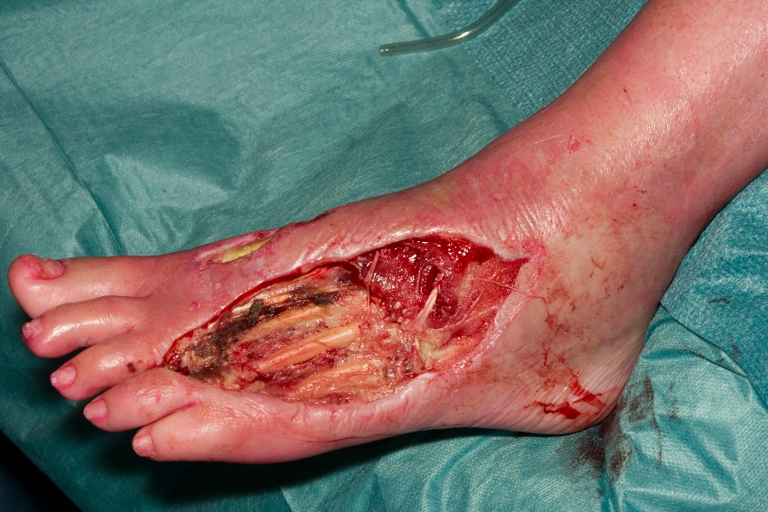
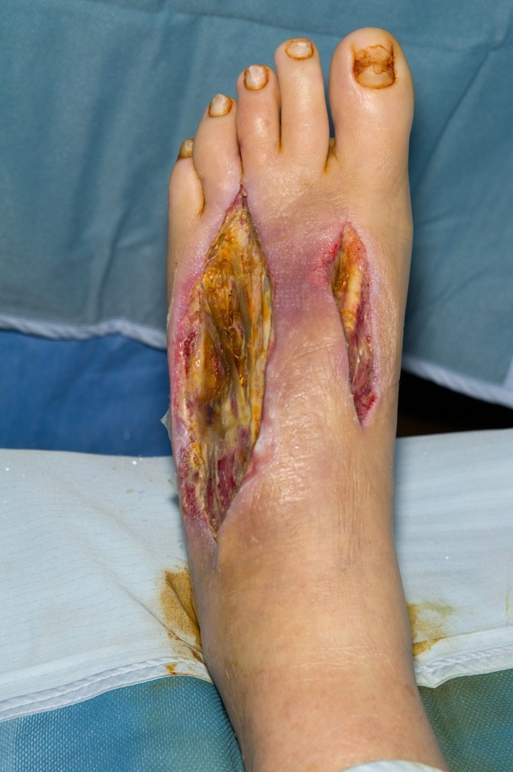
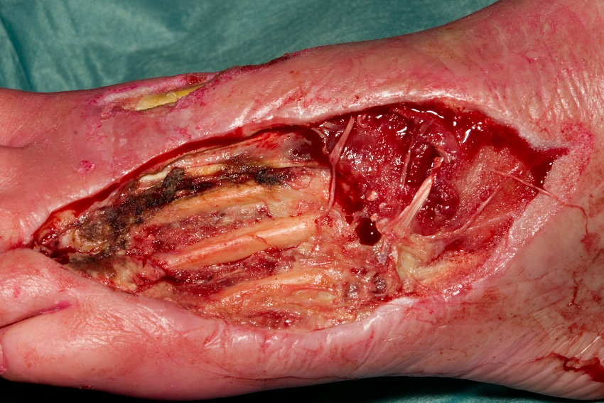
Prostheses

Slide 55
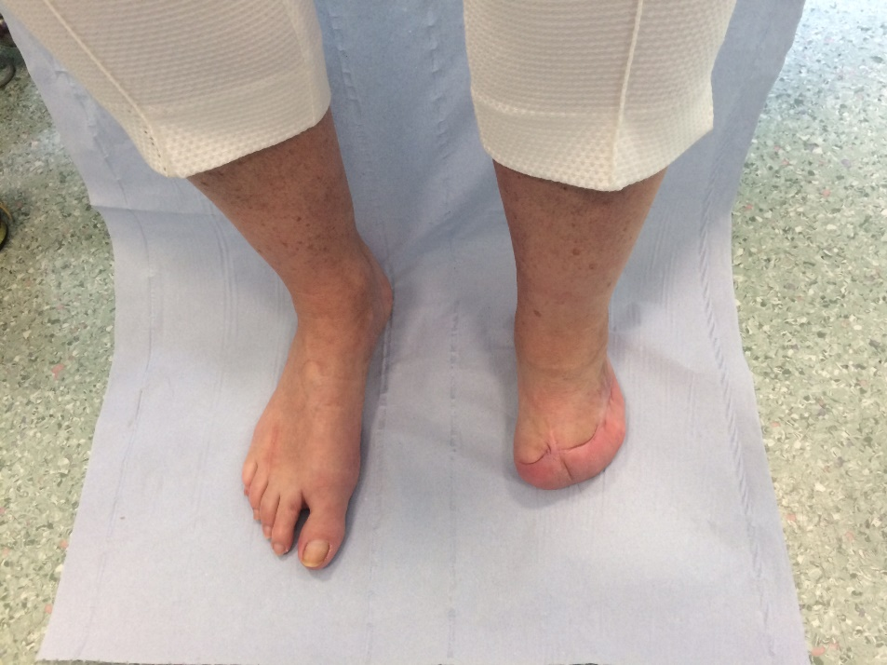
Prostheses

Slide 56
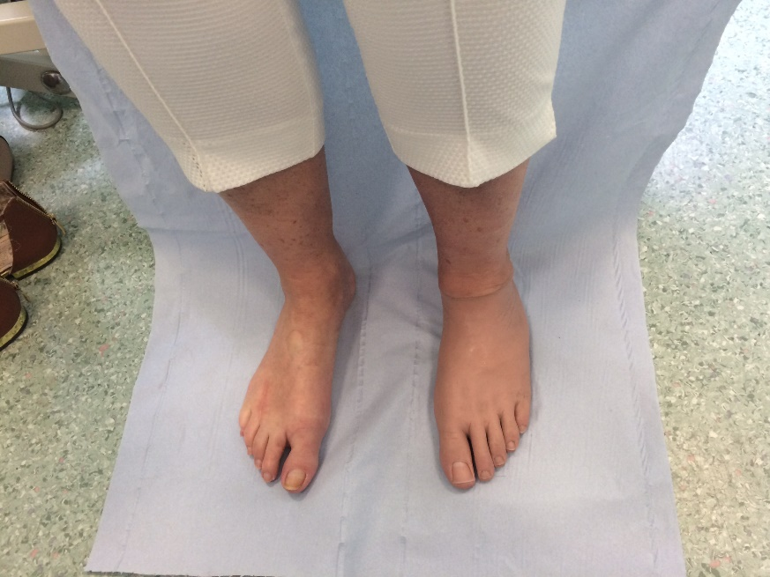
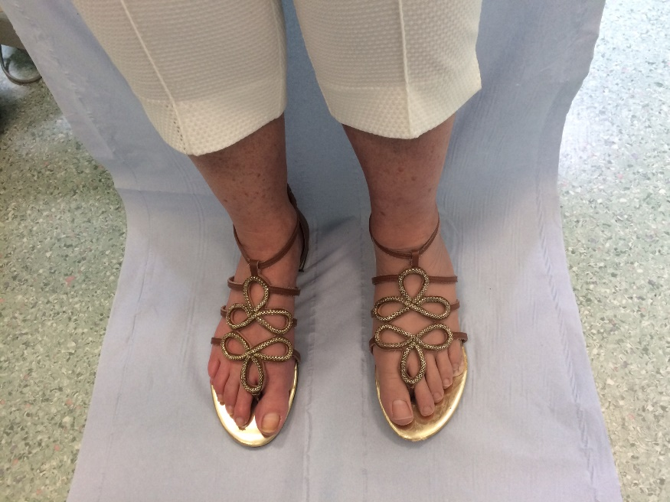
Prostheses

Slide 57
Sepsis Management Conclusions
Diabetic foot collections require urgent drainage
All infected, unhealthy, ischaemic tissue must be removed
Loeffler-Ballard incision allows access to all plantar compartments whilst preserving skeleton and healthy soft tissue for future reconstruction
Clean tissue and bone samples will help to guide antibiotic therapy
All cases must be managed within a multidisciplinary team

Slide 58
Learning Objectives Recap
Understand the aetiology of diabetic foot problems
Be aware of the strategies to prevent and manage diabetic foot complications
  Risk stratification
  Offloading
  Management of infection
  Assessment and management of ischaemia

